Slide 1
Team 10: Mesh Filter Pump for
Coronary Artery Disease Patients
Team 10
Cainwyn Leung
Claire HyoJoo Kim
Radhey Patel
Selina Qin

Slide 2
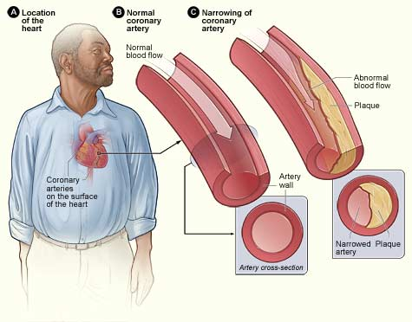
Background
Coronary Artery Disease
The narrowing or blockage of the coronary arteries—blood vessels that transport oxygenated blood to the heart muscle
Caused by the buildup of cholesterol and fatty deposits, called atherosclerotic plaques, inside the arteries
This causes chest pain (angina) or a heart attack

Slide 3
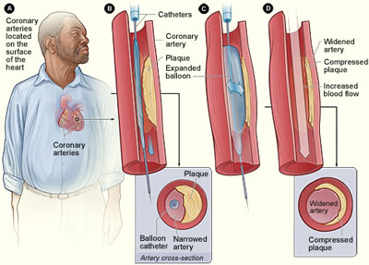
Background
Issues in Current Coronary Stent Technique
In-stent Restenosis
Formation of (neointimal) tissue inside the stent, triggered by vessel injury and the inflammatory response
May result in re-narrowing of the coronary arteries
Question in its long-term safety
Possibility for the late occurrence of thrombosis, blood clot forming in a blood vessel
Affected Population
Patients who have undergone angioplasty/stent insertions

Slide 4
Existing Solutions
Sternotomy:
Used a lot for heart procedures
Leaves a large scar
Highly invasive
Risks include infections, hemorrhage, dysrhythmia
Long recovery time
This technique is the most one of the oldest techniques to treat CAD, and it is considered a big surgery in treating blood clotting
Bare-metal Stent (BMS) & Drug eluting stent/ biodegradable stent(DES)
BMS insertion are the most common technology to treat heart clots, though it is far from being perfect
Have side effects of re-obstruction of more clots at the stent sites after the placement
Patients also need to take medication for the stent even after replacement to prevent re-clotting, and these medications can sometimes have side effects as well

Slide 5
Existing Solutions
Thrombolysis
A medication that is given 4-6 hours prior to a stroke
High death rate
May cause bleeding in the brain and happens one in 25 people 7 days within thrombolysis and is fatal about 1 in 40 cases
Thrombectomy
An endovascular procedure where a mesh is inserted by a catheter into the artery of clot and removes the clot altogether (X-ray imaging used continuously during the procedure).
This needs to be done within 5 hours of the stroke
Only works for large arteries
Risks of having respitory compromise and cranial nerve injury
Doesn't fully cure blood clot problems; re-obstruction occurs

Slide 6
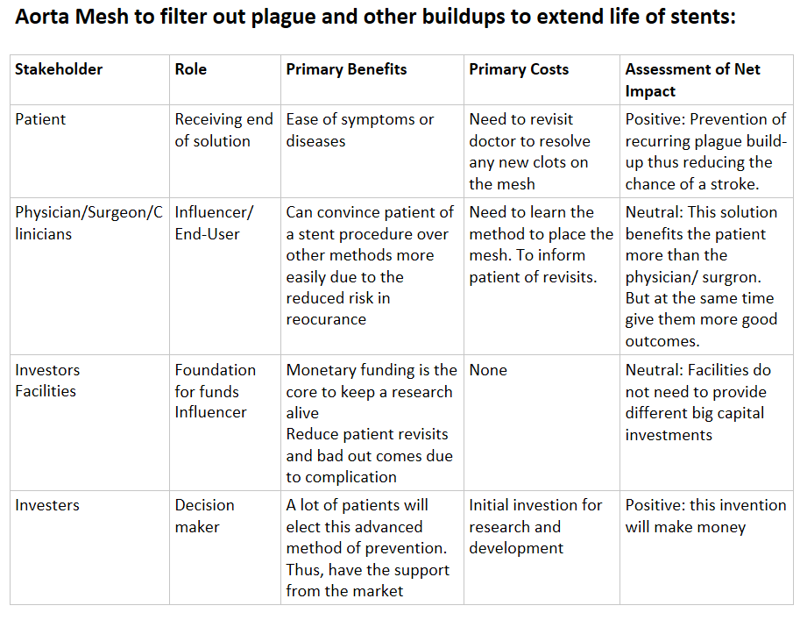
Stakeholder Analysis

Slide 7
Needs Statement
A way to prevent re-obstruction in existing stents for patients who have undergone angioplasty in order to reduce the risk of recurrence of strokes.

Slide 8
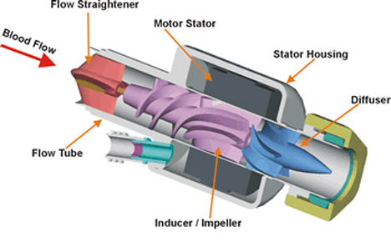
Design Solution Ideas
Inducer/Impeller Rotor
Diffuser
Internal Catheter
Filtration Mesh
Motorization Mechanism

Slide 9
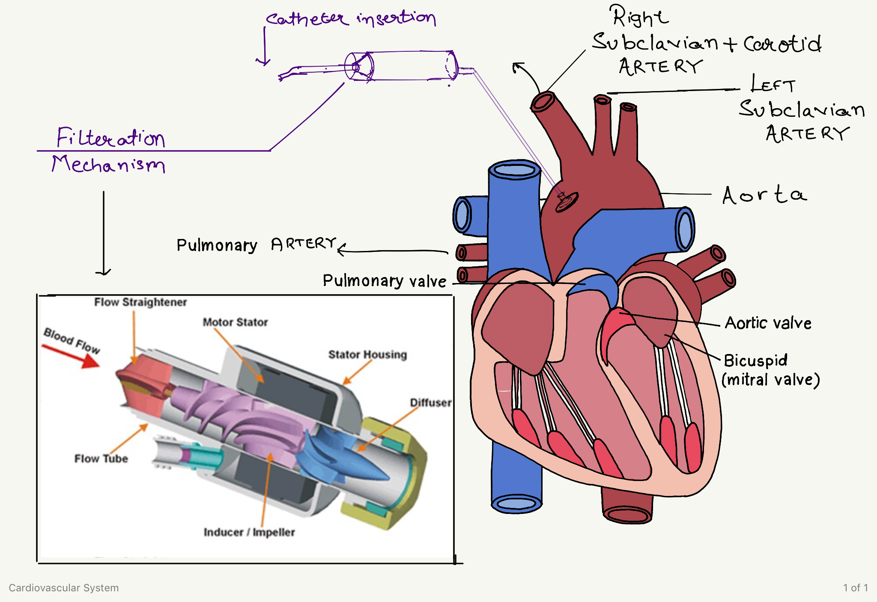

Slide 10
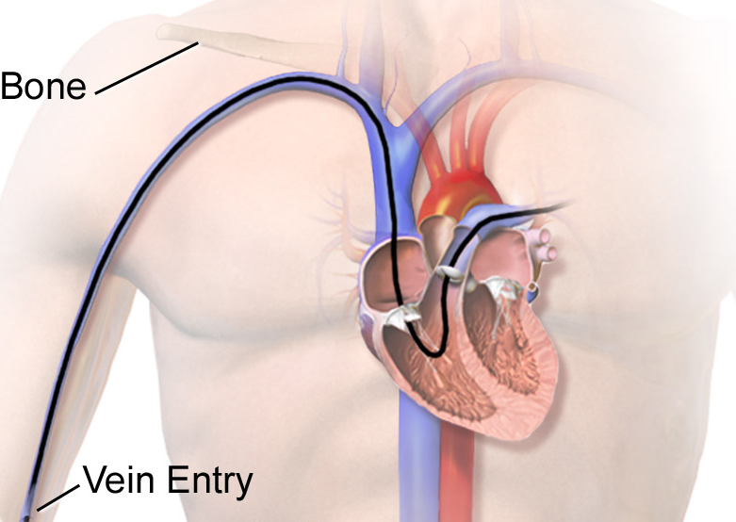
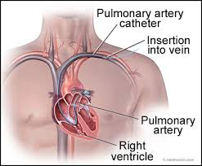
Insertion/Application

Slide 11
Questions
What kind of materials would be suitable?
How to stabilize pressure differential through the filtration mechanism?
What risks need to be assessed?
How should we manage the mechanical component of the filtration system while it's in the blood vessel?”

